Slide 1
Nutrition and Cancer Support
Kristen Curtis, MS, RDN, LDN
Registered Dietitian Nutritionist
The Villages Health

Slide 2
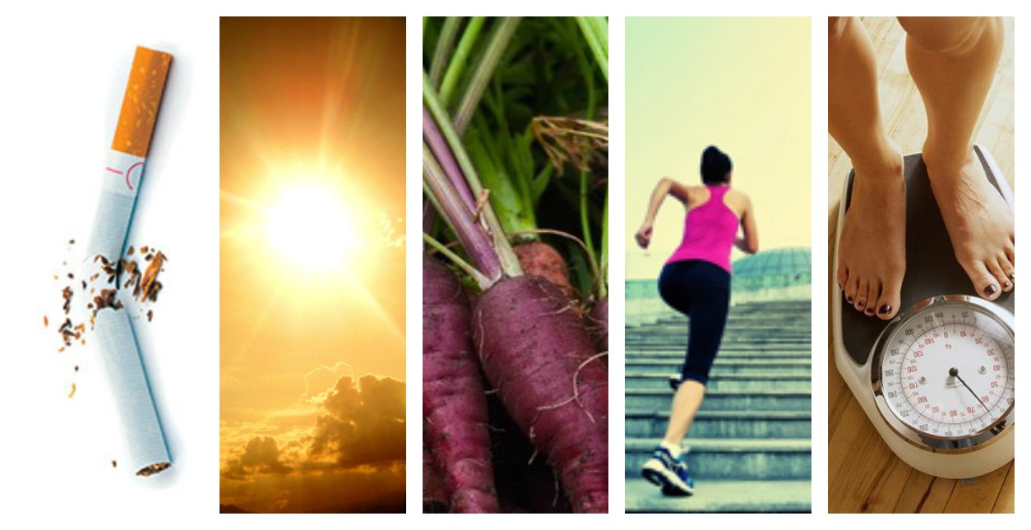
In the U.S. 1 in 4 people will develop cancer at some point in their lives Around 40% of cancer cases are preventable.

Slide 3
Cancer Prevention Recommendations
Staying at a healthy weight
Be physically active
Diet
Alcohol consumption
Not using supplements for cancer prevention
No tobacco products
Sun safety

Slide 4
Maintain A Healthy Weight
Avoid weight gain in adult life
As you age, your metabolism naturally slows down
Extra body fat can act like a hormone pump, which can spur cancer growth
Notes:
Be a healthy weight Keep your weight within the healthy range and avoid weight gain in adult life
Next to not smoking, maintaining a healthy weight is the most important thing you can do to reduce your risk of cancer. Aim to be at the lower end of the healthy Body Mass Index (BMI) range.
Body fat doesn’t just sit there on our waists – it acts like a ‘hormone pump’ releasing insulin, estrogen and other hormones into the bloodstream, which can spur cancer growth.

Slide 5
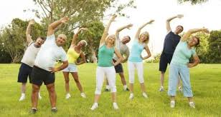
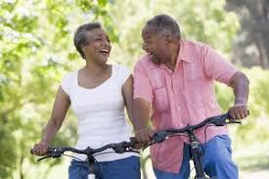
Be Physically Active
Subhead Here
Notes:
Physical activity in any form helps to lower cancer risk. Aim to build more activity, like brisk walking, into your daily routine.
Physical activity also helps to prevent weight gain, overweight and obesity, which increase risk of cancer.
Scientists recommend that we aim for a minimum of 150 minutes of moderate, or 75 minutes of vigorous, physical activity a week. For cancer prevention and weight control, higher levels of activity provide even more benefit. Work toward achieving 45 to 60 minutes moderate-intensity physical activity daily. Going beyond 60 minutes daily provides additional health benefits.
Emerging research is shows that sedentary behaviors – e.g. sitting at a computer, watching tv, – increase risk for weight gain, overweight and obesity. Break up your day by getting up and walking around a few minutes every hour.

Slide 6
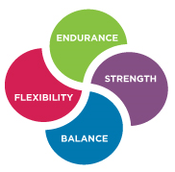
Types Of Exercise
Endurance
Strength
Balance
Flexibility
National Institute on Aging
Notes:
Exercise and physical activity fall into four basic categories — endurance, strength, balance, and flexibility. Most people tend to focus on one activity or type of exercise and think they're doing enough. Each type is different, though. Doing them all will give you more benefits. Mixing it up also helps to reduce boredom and cut your risk of injury.
Though we’ve described each type separately, some activities fit into more than one category. For example, many endurance activities also build strength. Strength exercises also help improve balance

Slide 7
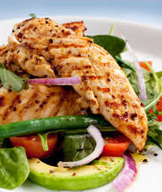
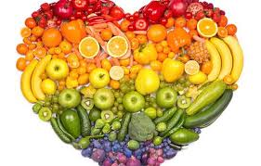
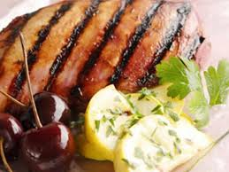
Diet

Slide 8
Eat A Diet Rich In Whole Grains, Vegetables, Fruits, and Beans
Aim to fill 2/3 of your plate with veggies, fruit, whole grains and beans
Plant based food are a good source of phytochemicals
Make these a major part of your usual diet.
Plant based foods can also help us maintain a healthy weight
Notes:
Eat a diet rich in whole grains, vegetables, fruits and beans
Make whole grains, vegetables, fruits and pulses (legumes) such as beans and lentils a major part of your usual daily diet
Basing our diets around plant foods (like vegetables, fruits, whole grains and beans), which contain fiber and other nutrients, can reduce our risk of cancer.
For good health, AICR recommends that we base all of our meals on plant foods. When preparing a meal, aim to fill at least two-thirds of your plate with vegetables, fruits, whole grains and beans.
As well as containing vitamins and minerals, plant foods are good sources of substances called phytochemicals. These are biologically active compounds, which can help to protect cells in the body from damage that can lead to cancer.
Plant foods can also help us to maintain a healthy weight because many of them are lower in energy density (calories).

Slide 9
Limit Consumption Of “Fast Foods”
Limit consumption of “fast foods” and other processed foods high in fat, starches or sugars
Limiting these foods helps control calorie intake and maintain a healthy weight
There is strong evidence that consuming "fast-foods" and a "Western-type" diet are causes of weight gain, overweight and obesity, which are linked to 12 cancers.
Notes:
Limit consumption of “fast foods” and other processed foods high in fat, starches or sugars
Limiting these foods helps control calorie intake and maintain a healthy weight
There is strong evidence that consuming "fast-foods" and a "Western-type" diet are causes of weight gain, overweight and obesity, which are linked to 12 cancers.
Glycemic load also increases risk for endometrial cancer.

Slide 10
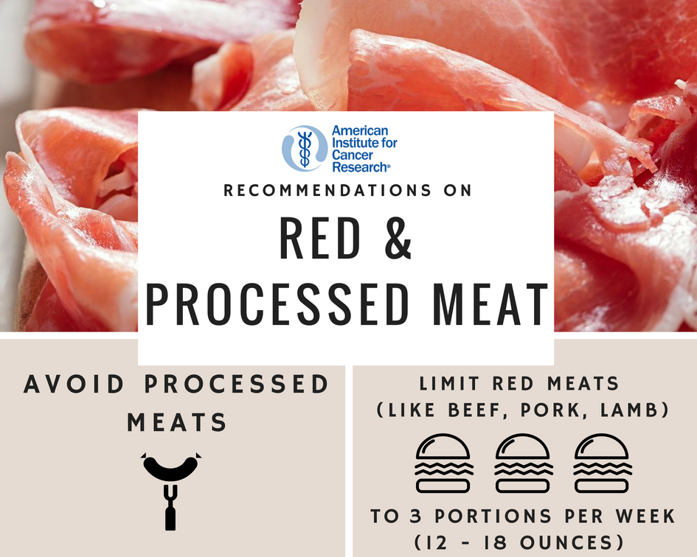
Limit Consumption Of Red And Processed Meat
Eat no more than moderate amounts of red meat, such as beef, pork and lamb.
Eat little, if any, processed meat
Notes:
Limit consumption of red and processed meat
Eat no more than moderate amounts of red meat, such as beef, pork and lamb. Eat little, if any, processed meat
The evidence that red meat (beef, pork and lamb) is a cause of colorectal cancer is convincing. Studies show, however, that we can consume modest amounts -- 12 to 18 ounces (cooked) per week -- without a measurable increase in colorectal cancer risk.
But when it comes to processed meat (ham, bacon, salami, hot dogs, sausages) the evidence is just as convincing, and cancer risk begins to increase with even very low consumption.
This is why the expert panel advises limiting red meat and avoiding processed meat.

Slide 11
Red Meat And Cancer Risk
The latest research shows that eating more than 18 ounces of red meat per week increases the risk of colorectal cancers.
Beef, lamb and pork are all red meats.
Cooking red meat at high temperatures can also produce other cancer-causing compounds.
Notes:
Red meat and cancer risk
The latest research shows that eating more than 18 ounces of red meat per week increases the risk of colorectal cancers. Beef, lamb and pork are all red meats.
Researchers do not yet know exactly how red meat affects the development of colorectal cancer. Red meat contains compounds that have been shown to damage the lining of the gut and possibly promote cancer. Cooking red meat at high temperatures can also produce other cancer-causing compounds.

Slide 12
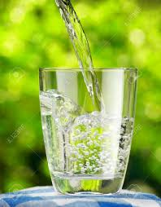
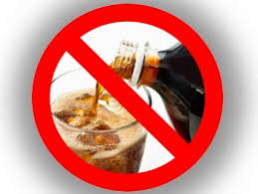
Limit Consumption Of Sugar-Sweetened Drinks
There is strong evidence that consuming sugar-sweetened beverages causes weight gain, overweight and obesity, linked to 12 cancers.
Sugar-sweetened beverages provide energy, but may not influence appetite in the same way as food does and can promote overconsumption of calories.
Notes:
Limit consumption of sugar-sweetened drinks
Drink mostly water and unsweetened drinks
There is strong evidence that consuming sugar-sweetened beverages causes weight gain, overweight and obesity, linked to 12 cancers.
Sugar-sweetened beverages provide energy, but may not influence appetite in the same way as food does and can promote overconsumption of calories

Slide 13
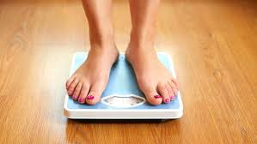
Sugar And Cancer Risk
Eating a lot of high-sugar foods may mean more calories than you need, which leads to excess weight and body fat.
It is excess body fat that increases risk of many common cancers.
AICR recommends eating a diet rich in nutritious and filling foods, such as whole grains, vegetables, fruit and beans.
Replacing sugary beverages with low- or no-calorie drinks
Notes:
Sugar and cancer risk
Does sugar feed cancer? This is one of our most frequently asked questions. There is no strong evidence that directly links sugar to increased cancer risk, yet there is an indirect link.
All cells in our body — including cancer cells — need sugar (glucose) from our bloodstream for fuel. We get that blood sugar from foods containing carbohydrates, including vegetables, fruits, whole grains and low-fat dairy sources. Some glucose is produced within our bodies from protein.
But eating a lot of high-sugar foods may mean more calories than you need, which leads to excess weight and body fat. It is excess body fat that increases risk of many common cancers. That is why AICR recommends eating a diet rich in nutritious and filling foods, such as whole grains, vegetables, fruit and beans and replacing sugary beverages with low- or no-calorie drinks.
Some strategies to help you eat less sugar include:
switch sodas for flavored sparkling water without added sugar
opt for unsweetened tea
add colorful fruit like berries, melon and citrus to your water
sprinkle cinnamon or cocoa on your coffee beverages and skip the sugar
carry healthy snacks like nuts, fresh or dried fruit or whole grain crackers and cheese instead of sugary snacks.

Slide 14
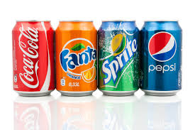
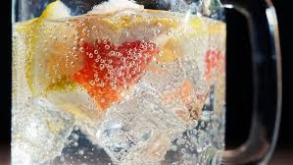
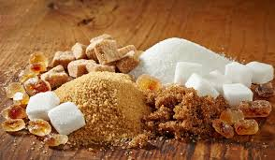
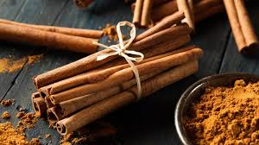
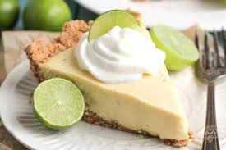
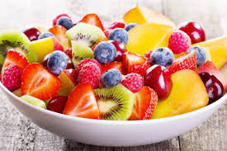
Notes:
Some strategies to help you eat less sugar include:
switch sodas for flavored sparkling water without added sugar
opt for unsweetened tea
add colorful fruit like berries, melon and citrus to your water
sprinkle cinnamon or cocoa on your coffee beverages and skip the sugar
carry healthy snacks like nuts, fresh or dried fruit or whole grain crackers and cheese instead of sugary snacks.

Slide 15
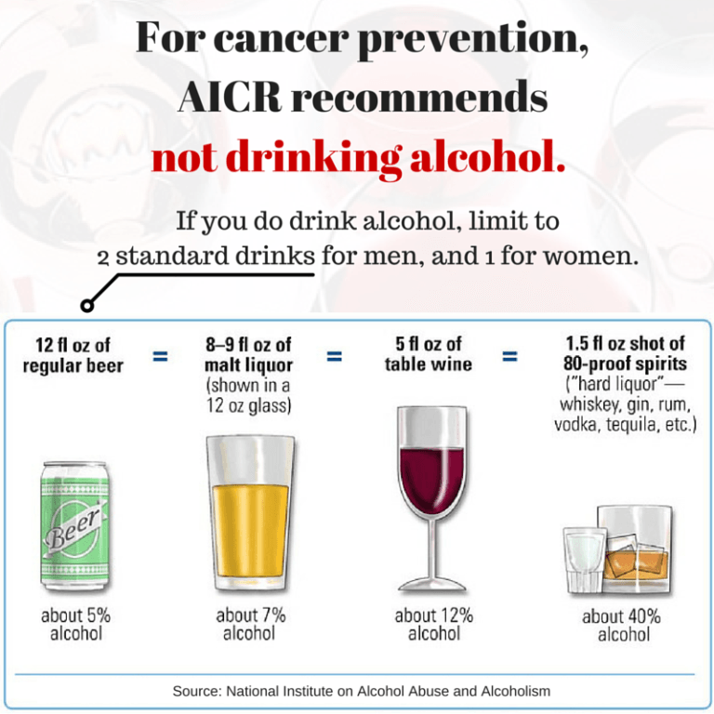
Limit Alcohol Consumption
For cancer prevention, it’s best not to drink alcohol.
If you do choose to drink alcohol, however, limit your consumption to one drink for women and two for men per day.
Notes:
Talk about the drink size!
For cancer prevention, it’s best not to drink alcohol
The best advice for those concerned about cancer is not to drink.
If you do choose to drink alcohol, however, limit your consumption to one drink for women and two for men per day.

Slide 16
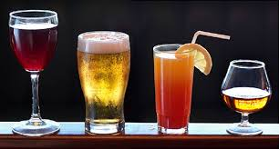
Alcohol And Cancer Risk
Previous research has shown that modest amounts of alcohol may have a protective effect against coronary heart disease.
But for cancer prevention, the evidence is clear and convincing: alcohol in any form is a potent carcinogen.
Notes:
Limit alcohol consumption
For cancer prevention, it’s best not to drink alcohol
Previous research has shown that modest amounts of alcohol may have a protective effect against coronary heart disease.
But for cancer prevention, the evidence is clear and convincing: alcohol in any form is a potent carcinogen. It's linked to 6 different cancers. The best advice for those concerned about cancer is not to drink.
If you do choose to drink alcohol, however, limit your consumption to one drink for women and two for men per day.

Slide 17
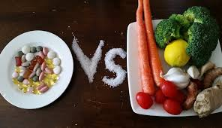
Do Not Use Supplements For Cancer Prevention
Aim to meet nutritional needs through diet alone
Notes:
Do not use supplements for cancer prevention Aim to meet nutritional needs through diet alone
For most people, it is possible to obtain adequate nutrition from a healthy diet that includes the right foods and drinks.
The panel doesn’t discourage the use of multivitamins or specific supplements for those sub-sections of the population who stand to benefit from them, such as women of childbearing age and the elderly. They simply caution against expecting any dietary supplement to lower cancer risk as well as a healthy diet can.
High-dose beta-carotene supplements have been linked to an increased risk for lung cancer in current and former smokers. It’s always best to discuss any dietary supplement with your doctor or a registered dietitian.

Slide 18
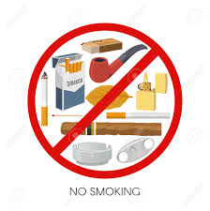
Orange Divider
Subhead Here
Notes:
Smoking and Cancer
Smoking tobacco is the leading cause of cancer worldwide, causing almost 6 million deaths each year. All of these deaths could be prevented if people did not smoke.
Tobacco smoke contains a number of known carcinogens – substances that cause cancer. Many people know that smoking causes lung cancer, but it can also cause many other types, including breast, colorectal, blood, bladder, liver, mouth, pancreatic and stomach cancer. Passive smoking (being exposed to someone else’s tobacco smoke) also increases the risk of lung cancer and is particularly dangerous for children.
All forms of tobacco cause cancer regardless of whether it is chewed; smoked, such as pipes, cigars, “light” cigarettes, roll-ups and shishas; or sucked and inhaled, such as smokeless tobacco and betel quid.
E-cigarettes (“vaping”) do not contain tobacco but there is conflicting information about their safety. They are not regulated, and their long-term impact on health is not yet known.
Not smoking or giving up smoking is the best way to reduce your own cancer risk and the risk to those around you, followed by maintaining a healthy weight, eating a healthy diet, and keeping active.
There is a lot of free information and support available to help with giving up smoking, from the National Institutes of Health and related factsheets from the Centers for Disease Control and Prevention.

Slide 19
Smoking And Cancer
Smoking tobacco is the leading cause of cancer worldwide, causing almost 6 million deaths each year.
Tobacco smoke contains a number of known carcinogens.
All forms of tobacco cause cancer.
Not smoking or giving up smoking is the best way to reduce your own cancer risk and the risk to those around you.
Notes:
Smoking tobacco is the leading cause of cancer worldwide, causing almost 6 million deaths each year. All of these deaths could be prevented if people did not smoke.
Tobacco smoke contains a number of known carcinogens – substances that cause cancer. Many people know that smoking causes lung cancer, but it can also cause many other types, including breast, colorectal, blood, bladder, liver, mouth, pancreatic and stomach cancer. Passive smoking (being exposed to someone else’s tobacco smoke) also increases the risk of lung cancer and is particularly dangerous for children.
All forms of tobacco cause cancer regardless of whether it is chewed; smoked, such as pipes, cigars, “light” cigarettes, roll-ups and shishas; or sucked and inhaled, such as smokeless tobacco and betel quid.
E-cigarettes (“vaping”) do not contain tobacco but there is conflicting information about their safety. They are not regulated, and their long-term impact on health is not yet known.
Not smoking or giving up smoking is the best way to reduce your own cancer risk and the risk to those around you, followed by maintaining a healthy weight, eating a healthy diet, and keeping active.
There is a lot of free information and support available to help with giving up smoking, from the National Institutes of Health and related factsheets from the Centers for Disease Control and Prevention.

Slide 20
Notes:
Sun, Vitamin D, and Cancer
The majority of skin cancer cases are caused by too much exposure to ultraviolet (UV) radiation from the sun and, increasingly, from sunbeds. Between 2 and 3 million skin cancers occur globally each year, and rates are rising. Melanoma, which is the least common but most serious type of skin cancer, causes the majority of deaths from the disease. The risk of melanoma rises with age, but it is increasingly one of the most common cancers among young people.
Most cases of skin cancer could be prevented by avoiding overexposure to UV rays. UVA and UVB are the two main types of sun rays, and both cause skin cancer by damaging the DNA in our skin cells. Some groups of people are more at risk of the skin damage that leads to skin cancer than others, including children and those with fair skin or red or light-colored hair. Sunburn also increases the risk of skin cancer; getting a sunburn just once every two years can triple your risk of melanoma. So if you’ve had sunburn in the past you need to do more to protect your skin in the future.
The best ways to enjoy the sun safely and protect yourself from sun damage that could lead to skin cancer are: not staying in the sun too long, especially between 11 am and 3 pm between March and October; applying high-factor sunscreen frequently; and wearing a hat, sunglasses, and clothes that cover your arms and legs. It’s important to protect your skin even when you already have a tan. Avoid using sunbeds or tanning booths. Fake tan is safer than using sunbeds, but Melanotan injections are illegal and unsafe.
Vitamin D -- Some people can get enough vitamin D by enjoying the sun safely and, as it is also found in foods, by eating a healthy diet.
People who have a higher risk of vitamin D deficiency are being advised to take a supplement all year round.
Visit the National Institutes of Health for more information on sunlight and cancer.

Slide 21
Sun And Cancer
The majority of skin cancer cases are caused by too much exposure to ultraviolet (UV) radiation from the sun and, increasingly, from sunbeds.
Most cases of skin cancer could be prevented by avoiding overexposure to UV rays
Some groups of people are more at risk of the skin damage that leads to skin cancer than others, including children and those with fair skin or red or light-colored hair.
Sunburn also increases the risk of skin cancer; getting a sunburn just once every two years can triple your risk of melanoma.
Notes:
Sun, Vitamin D, and Cancer
The majority of skin cancer cases are caused by too much exposure to ultraviolet (UV) radiation from the sun and, increasingly, from sunbeds. Between 2 and 3 million skin cancers occur globally each year, and rates are rising. Melanoma, which is the least common but most serious type of skin cancer, causes the majority of deaths from the disease. The risk of melanoma rises with age, but it is increasingly one of the most common cancers among young people.
Most cases of skin cancer could be prevented by avoiding overexposure to UV rays. UVA and UVB are the two main types of sun rays, and both cause skin cancer by damaging the DNA in our skin cells. Some groups of people are more at risk of the skin damage that leads to skin cancer than others, including children and those with fair skin or red or light-colored hair. Sunburn also increases the risk of skin cancer; getting a sunburn just once every two years can triple your risk of melanoma. So if you’ve had sunburn in the past you need to do more to protect your skin in the future.
The best ways to enjoy the sun safely and protect yourself from sun damage that could lead to skin cancer are: not staying in the sun too long, especially between 11 am and 3 pm between March and October; applying high-factor sunscreen frequently; and wearing a hat, sunglasses, and clothes that cover your arms and legs. It’s important to protect your skin even when you already have a tan. Avoid using sunbeds or tanning booths. Fake tan is safer than using sunbeds, but Melanotan injections are illegal and unsafe.
Vitamin D -- Some people can get enough vitamin D by enjoying the sun safely and, as it is also found in foods, by eating a healthy diet.
People who have a higher risk of vitamin D deficiency are being advised to take a supplement all year round.
Visit the National Institutes of Health for more information on sunlight and cancer.

Slide 22
After A Cancer Diagnosis
Check with your health professional about what is right for you
Anyone who has received a diagnosis of cancer should receive specialized nutritional advice from an appropriately trained professional.
Notes:
After a cancer diagnosis: follow our Recommendations, if you can
Check with your health professional about what is right for you
Anyone who has received a diagnosis of cancer should receive specialized nutritional advice from an appropriately trained professional. Once treatment has been completed, if you are able to do so (and unless otherwise advised), aim to follow AICR’s cancer prevention recommendations for diet, physical activity and healthy weight maintenance.
For breast cancer survivors, there is persuasive evidence that nutritional factors and physical activity reliably predict important outcomes from breast cancer.

Slide 23
Nutrition During Cancer Treatment
Nutrition is an important thing to consider when you're getting cancer treatment. Eating healthy foods before, during, and after treatment can help you feel better and stay stronger. But cancer and its treatment can sometimes cause problems that can make it hard to eat.

Slide 24
Nutrition During Cancer Treatment
During cancer treatment you might need to change your diet to help build up your strength and withstand the effects of the cancer and its treatment. This may mean eating things that aren’t normally recommended when you are in good health
For instance, you might need high-fat, high-calorie foods to keep up your weight, or thick, cool foods like ice cream or milk shakes because sores in your mouth and throat are making it hard to eat anything.

Slide 25
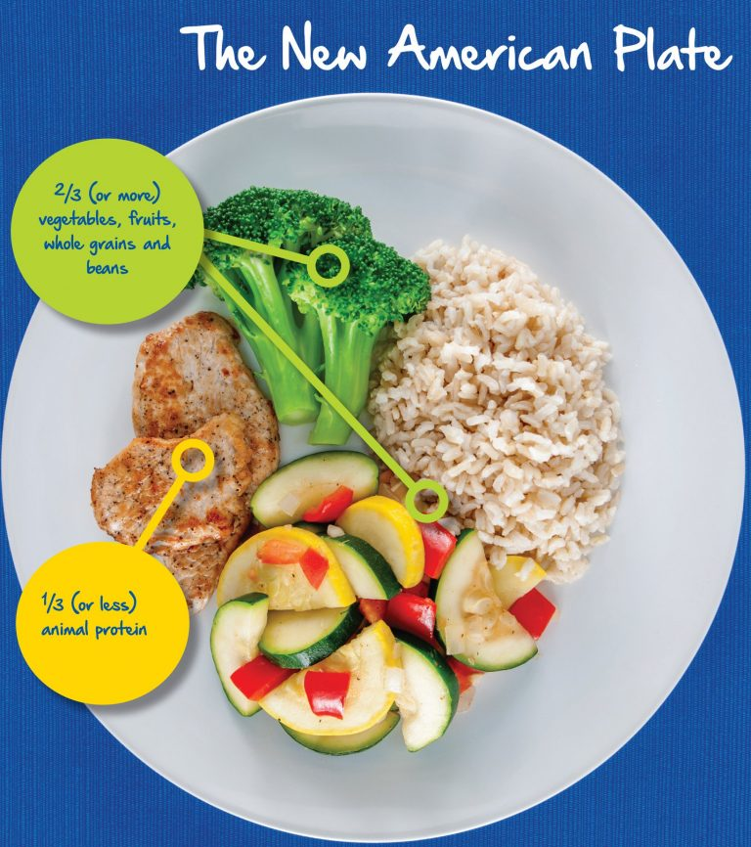
What is Good Nutrition?
Eating well means eating a variety of foods to get the nutrients your body needs to fight cancer. These nutrients include proteins, fats, carbohydrates, water, vitamins, and minerals.

Slide 26
Protein
We need protein for growth, to repair body tissue, and to keep our immune systems healthy. When your body doesn’t get enough protein, it might break down muscle for the fuel it needs. This makes it take longer to recover from illness and can lower resistance to infection. People with cancer often need more protein than usual. After surgery, chemotherapy, or radiation therapy, extra protein is usually needed to heal tissues and help fight infection.

Slide 27
Sources of Protein
Fish, poultry, lean red meat, eggs, low-fat dairy products, nuts and nut butters, dried beans, peas and lentils, and soy foods.

Slide 28
The Soy Saga
Foods like edamame, tofu, and unsweetened soy milk have been shown to reduce the risk of certain cancers such as breast, prostate and gastric.
Questions about the potential estrogenic activity of soy can lead to confusion about the safety of soy foods, particularly for those with estrogen-receptor positive breast cancer.

Slide 29
Soy
No one food is capable of single-handedly disrupting hormones linked to cancer growth.
Current Research supports inclusion of soy foods in the diet for general cancer prevention and for people with cancer.
Three types:
Soy foods- edamame, tofu, soy milk
Soy protein supplements- protein powder or bars made with soy protein isolate
Soy condiments/by-products- soy sauce, soybean oil

Slide 30
Fats
Fats and oils serve as a rich source of energy for the body. The body breaks down fats and uses them to store energy, insulate body tissues, and transport some types of vitamins through the blood.

Slide 31
Carbohydrates
Carbohydrates are the body’s major source of energy. Carbohydrates give the body the fuel it needs for physical activity and proper organ function. The best sources of carbohydrates – fruits, vegetables, and whole grains – also supply needed vitamins and minerals, fiber, and phytonutrients to the body’s cells.

Slide 32
Phytochemicals
Stimulate the immune system
Reduce
Reduce inflammation
Prevent
Prevent DNA damage and help with DNA repair
Rate
Slow rate of cancer cells
Help
Help regulate hormones
Stimulate
Studies have shown that phytochemicals have the potential to:

Slide 33
Phytochemical | Plant Source | Possible Benefits
Carotenoids | Red, orange and green fruits and vegetables | Inhibit cancer cell growth, work as antioxidants and improve immune response
Flavonoids | Apples, citrus fruits, onions, soybeans, tofu, soy milk, edamame, coffee, tea | Inhibit inflammation and tumor growth, aid immunity and boost production of detoxifying enzymes in the body
Indoles and Glucosinolates | Broccoli, cabbage, collard greens, kale, cauliflower, Brussels Sprouts | Induce detoxification of carcinogens, limit production of cancer-related hormones, block carcinogens and prevent tumor grown
Inositol | Bran from corn, oats, rice, rye and wheat, nuts, soybeans, tofu, soymilk | Retard cell growth and work as antioxidant
Isoflavones | Soybeans and soy products (tofu, soy milk, edamame) | Inhibit tumor growth, limit production of cancer-related hormones and generally work as antioxidant
Isothiocyanates | Broccoli, cabbage, collard greens, kale, cauliflower, Brussels Sprouts | Induce detoxification of carcinogens, block tumor growth and work as antioxidants
Polyphenols | Green tea, grapes, wine, berries, citrus fruits, apples, whole grains, peanuts | Prevent cancer formation, prevent inflammation and work as antioxidants
Terpenes | Cherries, citrus fruit peel, rosemary | Protect cells from becoming cancerous, slow cancer cell growth, strengthen immune function, fight viruses, limit production of cancer-related hormones

Slide 34
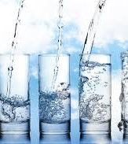
Water
Water and liquids or fluids are vital to health. All body cells need water to function. If you don’t take in enough fluids or if you lose fluids through vomiting or diarrhea, you can become dehydrated

Slide 35
Signs of Dehydration
Dry mouth/lips
Thirst
Dizziness/weakness
Difficulty swallowing
Dry skin
Cracked tongue
Higher body temperature
Weight loss
Constipation
Fatigue
Sunken eyeballs
Poor appetite and no thirst

Slide 36
Preventing Dehydration
Keep a food/fluid diary
Drink fluids (sometimes cold is better tolerated)
Consume fluid rich foods
Use lotion/lubricant on skin/mouth
Keep fluids within sight/reach
Suck on ice chips
Find proper treatment for diarrhea/vomiting

Slide 37
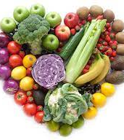
Health After Treatment
Most eating-related side effects of cancer treatments go away after treatment ends. But some side effects can last for some time. If this happens to you, talk to your cancer care team and work out a plan to manage the problem.

Slide 38
Tips for Eating After Treatment
Ask your dietitian to help you create a nutritious, balanced eating plan.
Try to eat a variety of colorful fruits and vegetables each day; include citrus fruits and dark-green and deep-yellow vegetables.
Eat plenty of high-fiber foods, like whole-grain breads and cereals.
Try to buy a different fruit, vegetable, low-fat food, or whole-grain product each time you shop for groceries.
Avoid or limit your intake of red meat and processed meats
Choose low-fat milk and dairy products.
Avoid/limit alcohol

Slide 39
Contact Information
Kristen Curtis, MS, RDN, LDN
Registered Dietitian Nutritionist
The Villages Health
352-674-1770
Kristen.Curtis@thevillageshealth.com

